Slide 1


Half-Day Seminar on
“Corporate Governance”
April 8th , 2017
Saturday, (3 pm – 6 pm)
Venue: 4th Floor, IEP Building 177/2, Liaquat Barracks, Karachi

Slide 2
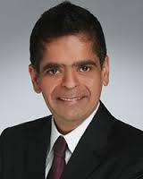
Expert Speaker
Mr. Sanjeev Gathani
Bachelor Degree in Banking and Finance from Monash University, Melbourne, Australia.
Started his career with Price water house Malaysia as an Audit Executive.
Involved in several Corporate World Investigations across the APAC Region.
Developed Compliance and Anti-Bribery Programs for US Multinational within the APAC Region.
Written articles in newspapers within the APAC Region on topics related to Corporate Governance.
To know more about his Expertise , Do attend the Free Seminar!

Slide 3
About the Seminar
Covers well-publicized failures in Corporate Governance.
Establishes the need for a thorough understanding of corporate governance and how to achieve best practice.
Involves highly interactive teaching approach (involving exercises, group work and case-studies).
Endeavours to develop a clear understanding of corporate governance framework in international context.
Relates Good Governance best practices in the post-Enron era.

Slide 4
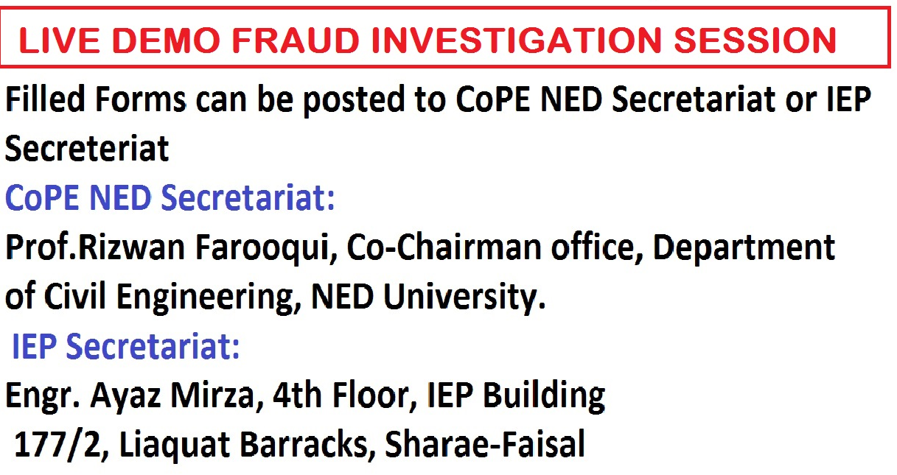

Free registrations (0.5 CPD)
EVENT MANAGER
CENTRE OF PROFESSIONAL EXCELLENCE – CoPE
NED UNIVERSITY OF ENGINEERING & TECHNOLOGY

